Slide 1
Information Retrieval
Topic- Text Classification & Naive Bayes
(Text Classification )
Lecture-34
Prepared By
Dr. Rasmita Rautray & Dr. Rasmita Dash
Associate Professor
Dept. of CSE

Slide 2
Text Classification

Slide 3
Content
Text Classification
Classification methods
Naive Bayes classifier

Slide 4
Relevance feedback: Basic idea
The user issues a (short, simple) query.
The search engine returns a set of documents.
User marks some docs as relevant, some as nonrelevant.
Search engine computes a new representation of the information need – should be better than the initial query.
Search engine runs new query and returns new results.
New results have (hopefully) better recall.

Slide 5
Types of query expansion
Manual thesaurus (maintained by editors, e.g., PubMed)
Automatically derived thesaurus (e.g., based on co-occurrence statistics)
Query-equivalence based on query log mining (common on the web as in the “palm” example)

Slide 6
Query expansion at search engines
Main source of query expansion at search engines: query logs
Example 1: After issuing the query [herbs], users frequently search for [herbal remedies].
→ “herbal remedies” is potential expansion of “herb”.
Example 2: Users searching for [flower pix] frequently click on the URL photobucket.com/flower. Users searching for [flower clipart] frequently click on the same URL.
→ “flower clipart” and “flower pix” are potential expansions of each other.

Slide 7
Text classification: definition & relevance to information retrieval

Slide 8
A text classification task: Email spam filtering
From: ‘‘’’ <takworlld@hotmail.com>
Subject: real estate is the only way... gem oalvgkay
Anyone can buy real estate with no money down
Stop paying rent TODAY !
There is no need to spend hundreds or even thousands for similar courses
I am 22 years old and I have already purchased 6 properties using the
methods outlined in this truly INCREDIBLE ebook.
Change your life NOW !
==============================================
Click Below to order:
http://www.wholesaledaily.com/sales/nmd.htm
==============================================

Slide 9
Formal definition of TC: Training
Given:
A document space X
Documents are represented in this space – typically some type of high-dimensional space.
A fixed set of classes C = {c1, c2, . . . , cJ}
The classes are human-defined for the needs of an application (e.g., spam vs. nonspam).
A training set D of labeled documents. Each labeled document
Using a learning method or learning algorithm, we then wish to learn a classifier γ that maps documents to classes:
γ : X → C

Slide 10
Formal definition of TC: Application / Testing
Given: a description d ∈ X of a document
Determine:
γ(d) ∈ C,
that is, the class that is most appropriate for d

Slide 11
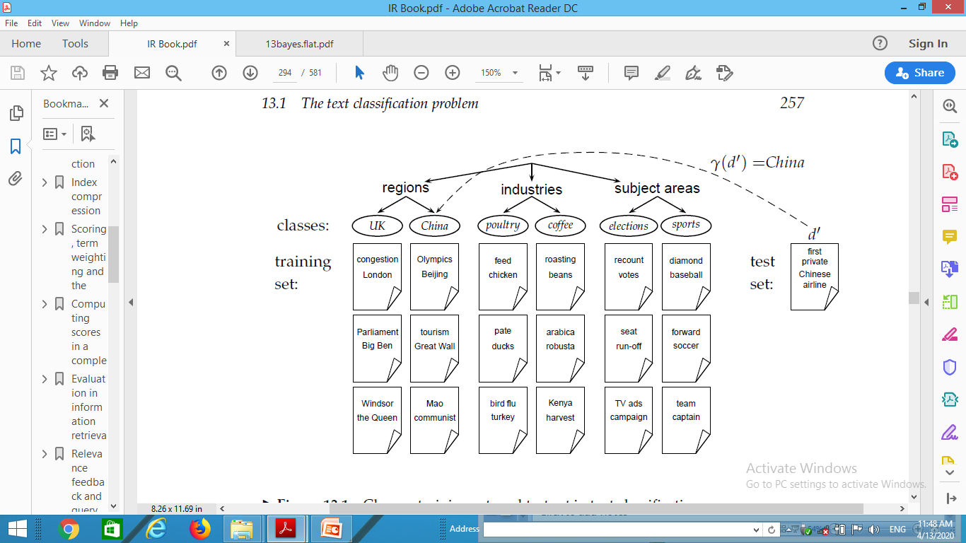
Topic classification

Slide 12
Examples of how search engines use classification
Language identification (classes: English vs. French etc.)
The automatic detection of spam pages (spam vs. nonspam)
Sentiment detection: is a movie or product review positive or negative (positive vs. negative)
Topic-specific or vertical search – restrict search to a “vertical” like “related to health” (relevant to vertical vs. not)

Slide 13
Classification methods: 1. Manual
Manual classification was used by Yahoo in the beginning of the web. Also: ODP, PubMed
Very accurate if job is done by experts
Consistent when the problem size and team is small
Scaling manual classification is difficult and expensive.
→ We need automatic methods for classification.

Slide 14
Classification methods: 2. Rule-based
E.g., Google Alerts is rule-based classification.
There are IDE-type development enviroments for writing very complex rules efficiently. (e.g., Verity)
Often: Boolean combinations (as in Google Alerts)
Accuracy is very high if a rule has been carefully refined over time by a subject expert.
Building and maintaining rule-based classification systems is cumbersome and expensive.

Slide 15
Classification methods: 3 Statistical/Probabilistic
This was our definition of the classification problem – text classification as a learning problem
(i) Supervised learning of a the classification function γ and
(ii) application of γ to classifying new documents
We will look at two methods for doing this: Naive Bayes and SVMs
No free lunch: requires hand-classified training data
But this manual classification can be done by non-experts.

Slide 16
The Naive Bayes classifier
The Naive Bayes classifier is a probabilistic classifier.
We compute the probability of a document d being in a class
c as follows:
n_{d} is the length of the document. (number of tokens)
P(t_{k} |c) is the conditional probability of term t_{k} occurring in a document of class c
P(t_{k} |c) as a measure of how much evidence t_{k} contributes that c is the correct class.
P(c) is the prior probability of c.
If a document’s terms do not provide clear evidence for one
class vs. another, we choose the c with highest P(c).

Slide 17
Maximum a posteriori class
Our goal in Naive Bayes classification is to find the “best” class.
The best class is the most likely or maximum a posteriori (MAP) class c_{map}:

Slide 18
Naive Bayes classifier
Classification rule:
Simple interpretation:
Each conditional parameter log ˆP (t_{k} |c) is a weight that indicates how good an indicator tk is for c.
The prior log ˆP (c) is a weight that indicates the relative frequency of c.
The sum of log prior and term weights is then a measure of how much evidence there is for the document being in the class.
We select the class with the most evidence.

Slide 19
Thank You

